Slide 1
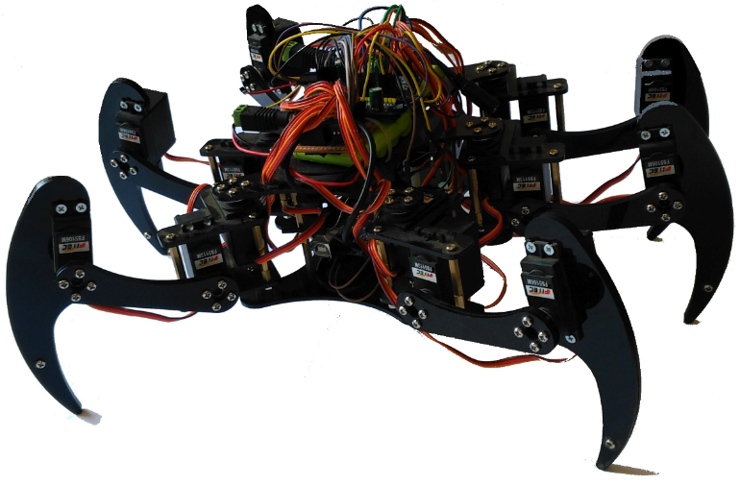

ZagHexa: Design, Construction and Control of a Hexapod Walking Robot
2nd IUGRC International Undergraduate Research Conference,
Military Technical College, Cairo, Egypt, July 24-27, 2017.
Khaled Mohamed Risha | Mahmoud Mohamed Awadallah | Muhammad Alaa Muhammad
khaledrisha@gmail.com | mahmoud.elsyed21@gmail.com | 3bqar10@gmail.com
Amira Elsayed Soliman Fadaly | Hend Khairy Abdelhamed | Nehad Abdelsalam Afifi
amirafadaly90@gmail.com | enghkho@gmail.com | engvida2@gmail.com
Supervisor:
Dr. Ing. Mohammed Nour
mnahmed@eng.zu.edu.eg, https://mnourgwad.github.io

Slide 2
Abstract
ZagHexa is an eighteen DOF (degree of freedom) hexapod robot. The three DOF leg design means this robot can walk in any direction (both translate and rotate) as well as tilt its body in place. Our main goal is to produce an efficient walking machine that is designed and built with performance suitable for as many as possible applications. ZagHexa is based on the well-known Robots Operating System (ROS) to be as distributed and modular as possible.
This paper describes: The design and control hexapod robot: ZagHexa . Remotely operated lightweight robot Hexapods able to detect land mines, traverse rocky and unstable terrain. Carry out simple delivery missions in danger zones. The design of the robot and its building subsystems our approach of how the robot is controlled and localized to provide real-time 3D pose.

Slide 3
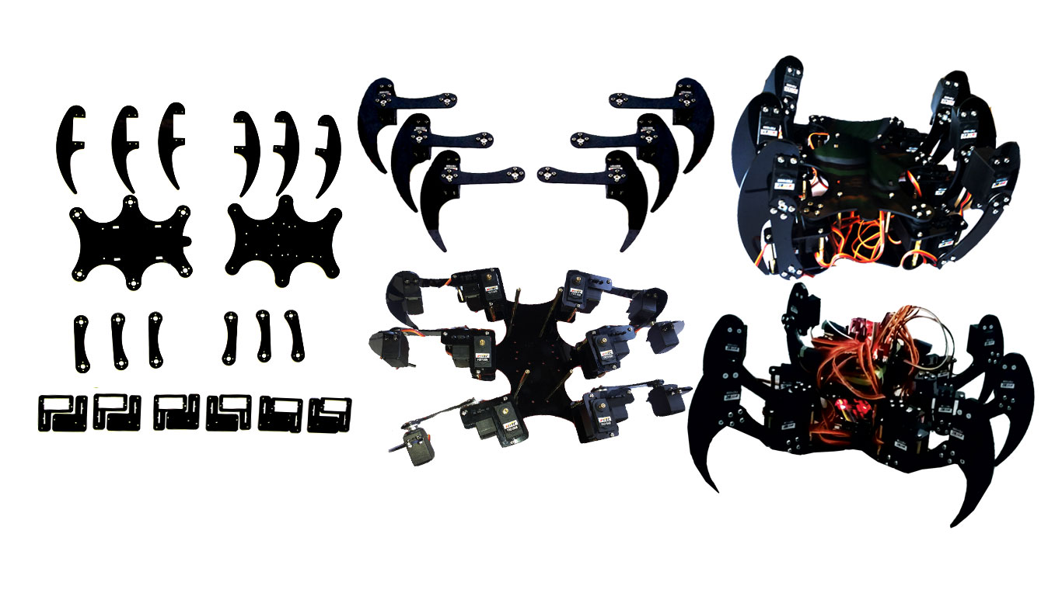
General Mechanical Design

Slide 4
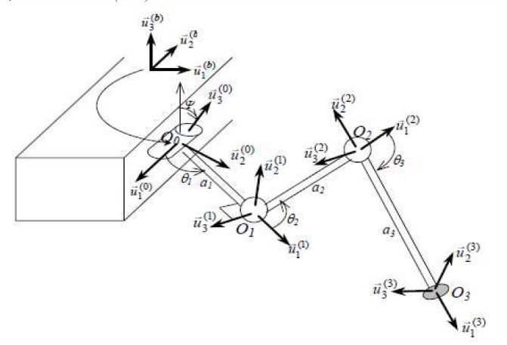
Drivetrain

Slide 5
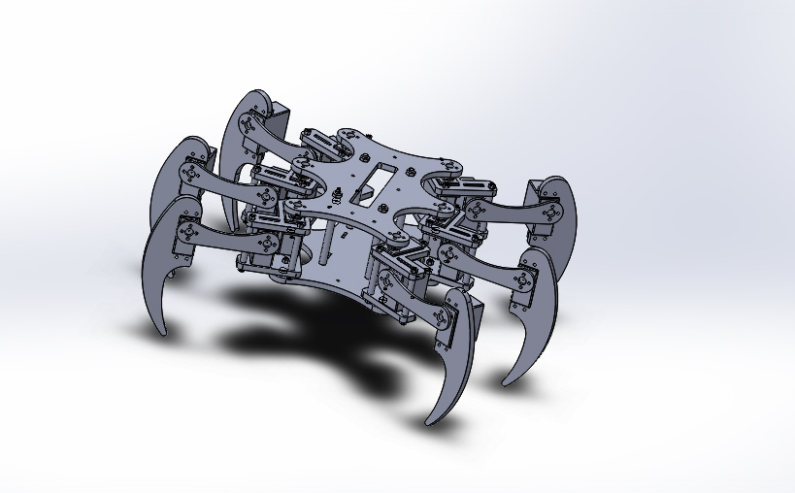
CAD Model

Slide 6
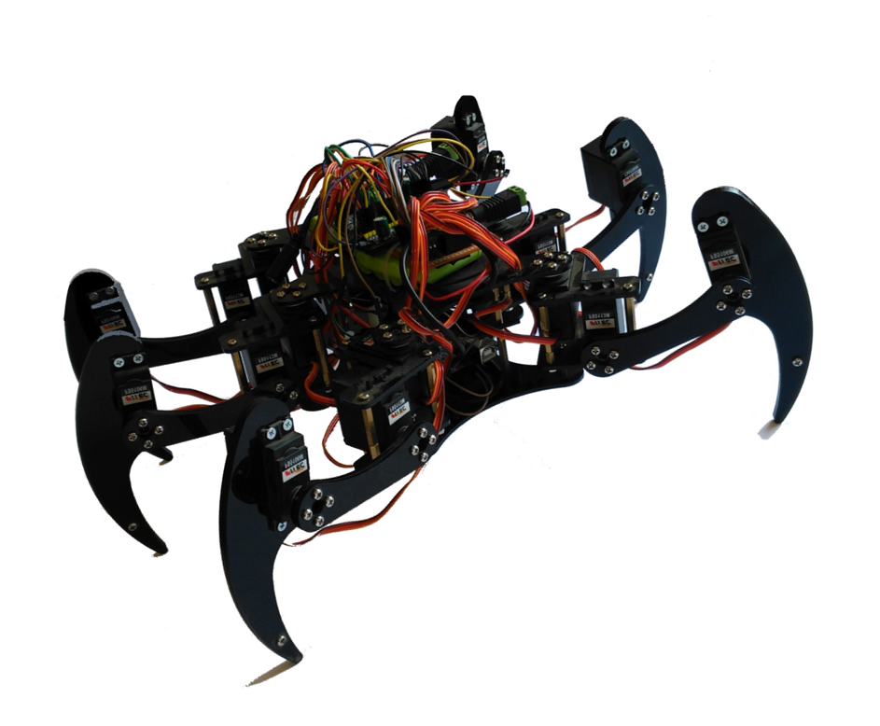
Chassis

Slide 7
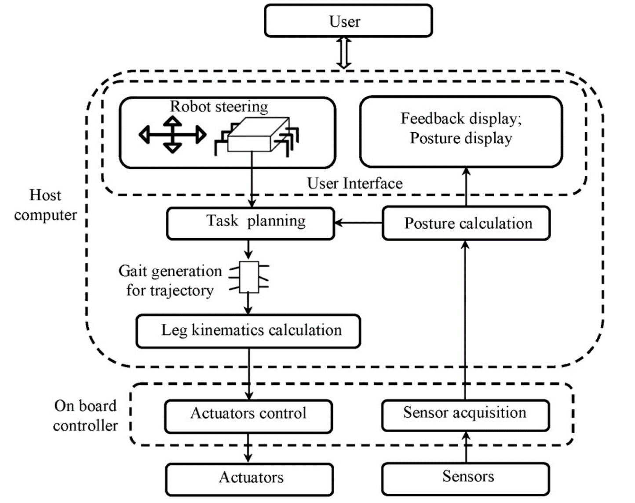
Outline of control systems

Slide 8



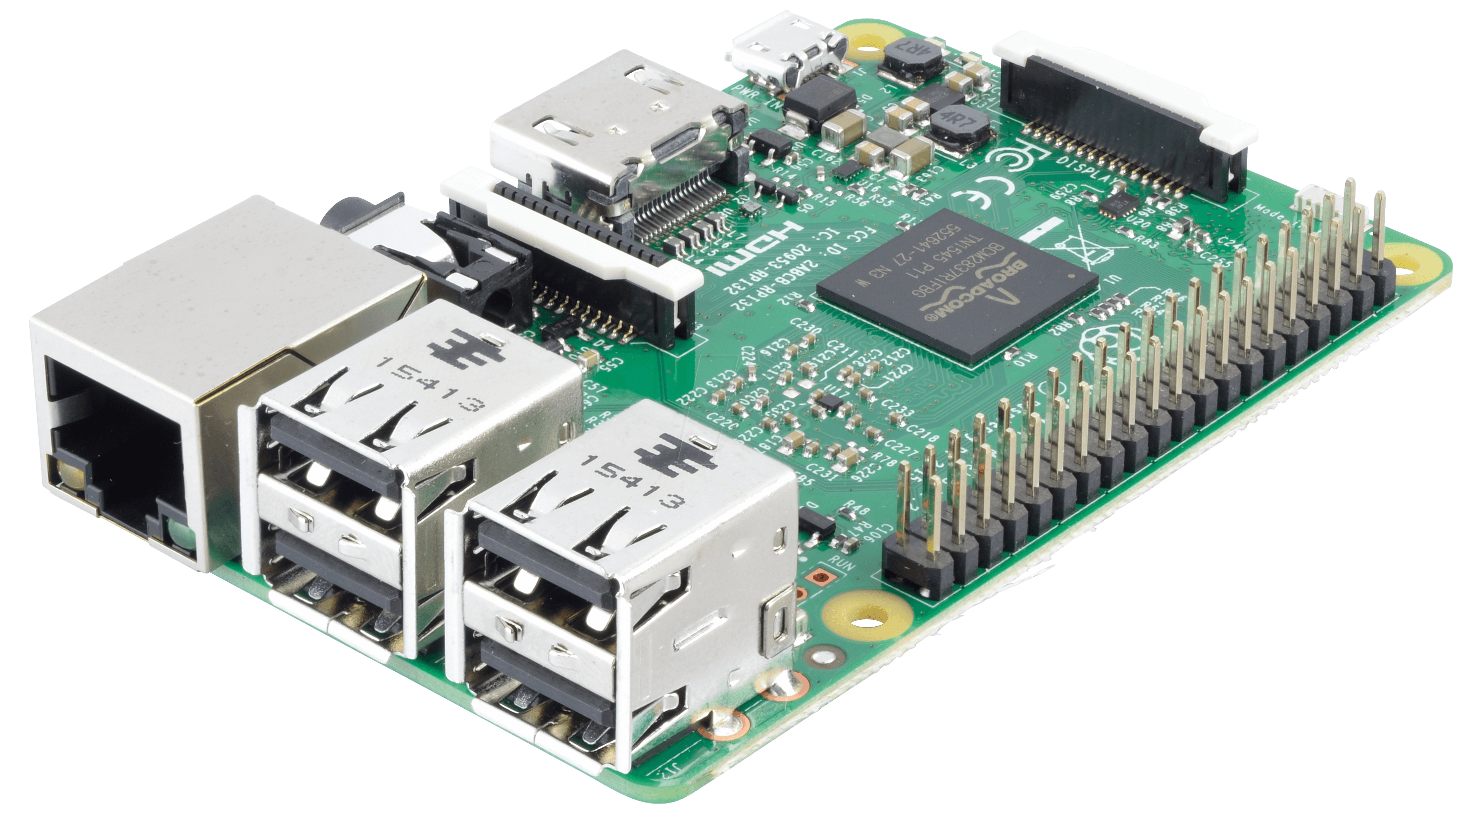




System Design and Control
ZagHexa onboard subsystems
control node
Sensors and camera nodes
Android
Wireless Transmission
Remote Control
GUI, Control & 3D Position Tracker
Android
Operator
Control Station

Slide 9


System Design and Control
GUI, Control & 3D Position Tracker
Wireless
Transmission
Control node
Sensors and camera nodes
Control Station
Operator
Remote Control
ZagHexa onboard subsystems

Slide 10
System Design and Control
PCA9685
Servocontroller
Raspberry pi 3B
Ubuntu
Kinetic Kame ROS
USB
USB hub
USB
USB
PWM
Motors
BT
Camera
Gyro &
Acceler
servos
WiFi
Sensors
Smart
Phones

Slide 11

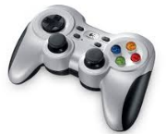
System Design and Control
ZagHexa onboard subsystems
control node
sensors, camera & localization nodes
Wireless Transmission
Remote Control
GUI, Control & 3D Position Tracker
Operator
Control Station

Slide 12

ZagHexa: System Overview
Mechanical Parameter
 | Dimensions | 38 cm x 28 cm x 15 cm
 | System Mass | ~1.2kg
 | Velocity | 50 cm/sec on vertical ferrous surfaces
 | Actuation | 2 x 12 V DC gear motors
 | wheels | 2x50 neodymium magnets
On Board Data Handling
 | On Board Computer | gumstix Robovero + AirSTORM COM
Communications
 | W-LAN | 802.11 b/g
 | Remote Control | wireless/WiFi
Power Supply
 | Primary Battery | LiPo: 11.1 V - 800 mAh
 | Bus Voltages | 12V; 5V
 | Average power | 75W (straight driving)
Navigation Sensors
 | sensors | Gyroscope , Accelerometer, Camera
 | Camera | EGO727: IP video camera

Slide 13
ZagHexa Robot (Stage 2)
Technical Data
Weight: 1.2kg
Size: 38 x 28 x 15cm
Speed: 50cm/sec
Battery: 11.1V /800mAh
Autonomy: 30 min
Control: 35MHz
Payload: 2 Cameras, LED

Slide 14
Conclusion
This paper describes: The design and control of a magnetic wall-climbing robot: ZagHexa Robot Remotely operated lightweight robot Hexapods able to detect land mines, traverse rocky and unstable terrain. . The design of the robot and its building subsystems Legged design improves climbing behavior on uneven walls our approach of how the robot is controlled and localized to provide real-time 3D pose.

Slide 15
Future work
Autonomous Robot
Improve ability to climb on rusty surfaces
Further test with localization techniques
Include Computer Vision

Slide 16
Thank you
Computer and System Engineering Dept. Faculty of Engineering,
Zagazig University,
Sharkia, Egypt
Dr. Ing. Mohammed Nour
mnahmed@eng.zu.edu.eg
https://mnourgwad.github.io

